Slide 1
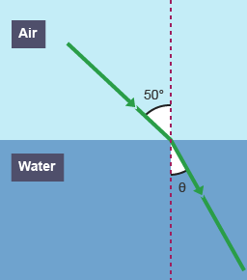
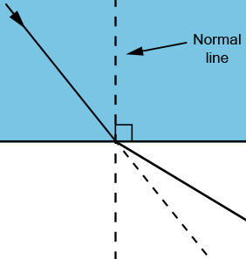
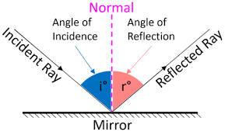
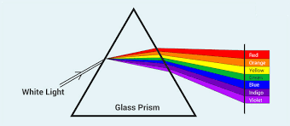
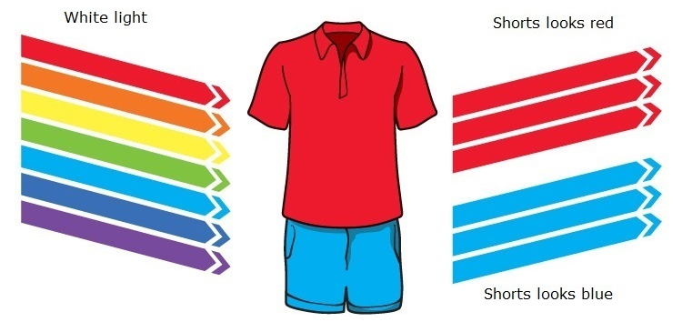
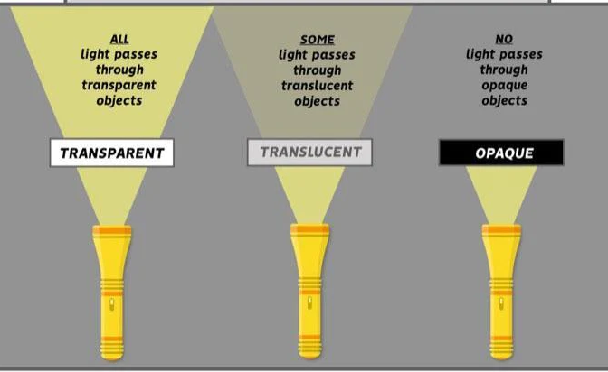
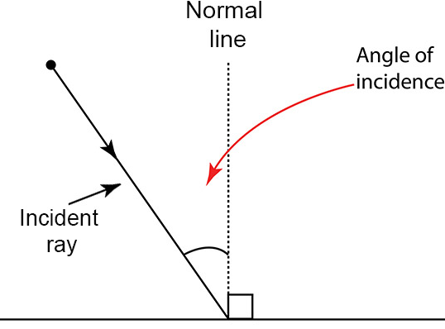
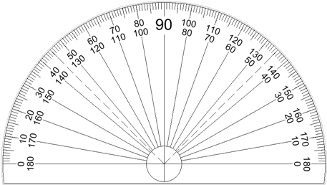
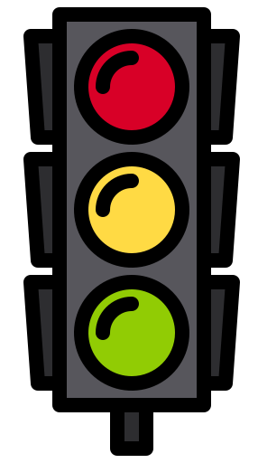

Knowledge Organiser
Year 8: Waves – Light Waves
The law of reflection…
Angle of incidence
Angle of reflection
=
Drawing ray diagrams for refraction:
If the refractive index of the new material is higher, the ray will bend towards the normal
If the refractive index of the new material is lower, the ray will bend away from the normal
What is the law of reflection?
The law of reflection states that the angle of incidence is equal to the angle of reflection
These angles are measure from the normal line
This is a line which is drawn perpendicular (at a right angle to) the position that the light ray hits the reflective surface
How does light behave?
Light travels in straight lines as a transverse waves
Light is part of the electromagnetic spectrum, all EM waves travel at 300,000,000 m/s
White light is made of a mixture of all the different colours found in visible light
Two ray diagrams showing a ray moving from 1. a low to high refractive index and 2. a high to low refractive index
A diagram which illustrates the law of reflection
A diagram showing how a glass prism can split up white light into all the different wavelengths
How do we see coloured objects?
When light hits an object, only one frequency is reflected, all others are absorbed by the object
If no light is reflected by the object, it will appear black
If all frequencies of light are reflected by the object, it will appear white
A diagram comparing transparent, translucent and opaque objects
A diagram which shows how to measure the angle of incidence
How to measure the angles:
Draw a normal line at 90 degrees from the mirror plane
Place your protractor lined up with the normal line
Measure the angle from 0 to the ray (shown in blue)
RAG Yourself!
Learning Outcomes; | RAG
Compare the speed of sound and light
Define the key terms transparent and opaque
State the law of reflection
Draw ray diagrams to illustrate the law of reflection
Measure the angle of incidence on a ray diagram
Explain how coloured objects are seen
Explain why light is refracted when it travels between mediums
How does reflection work?
Light waves can be reflected, which means to throw back without absorbing
The rays of light follow the law of reflection when they hit a reflective surface
What is refraction?
When a ray of light travels from one material to another it can change its speed
When the ray changes speed it will also change direction, this is called refraction
The direction and size of the change depends on the difference in refractive index between the two materials

Slide 2
Knowledge Organiser
Year 8: Waves – Light Waves
The law of reflection…
Drawing ray diagrams for refraction:
What is the law of reflection?
How does light behave?
Two ray diagrams showing a ray moving from 1. a low to high refractive index and 2. a high to low refractive index
A diagram which illustrates the law of reflection
A diagram showing how a glass prism can split up white light into all the different wavelengths
How do we see coloured objects?
A diagram comparing transparent, translucent and opaque objects
A diagram which shows how to measure the angle of incidence
How to measure the angles:
RAG Yourself!
Learning Outcomes; | RAG
Compare the speed of sound and light
Define the key terms transparent and opaque
State the law of reflection
Draw ray diagrams to illustrate the law of reflection
Measure the angle of incidence on a ray diagram
Explain how coloured objects are seen
Explain why light is refracted when it travels between mediums
How does reflection work?
What is refraction?

